Slide 1
Claim Registration Using RPA
Project Guide
Academic Guide:Mr R.Sathish (Assistant Professor)
Industry Guide:Mrs.Yukthika / Mrs.Pavithra
Team Members
B.Shivaram(15ita30)
K.Dini Kokila(15ita05)
R.Aishwarya(15ita37)

Slide 2
Problem statement
Many insurance companies are struggling to process large number of claim requests, as this is a repeated task for the customer support executives for processing big set of claims. To solve this problem we are using RPA automation to register multiple claims for immediate processing in motor general insurance.

Slide 3
ABSTRACT
The automated process, is a trending technology to reduce human repeated works like data entry. The insurance company has to register a claim, for the given insurance policy number and also has different registration processes according to the insurance applied by the client.
This project is based on claiming Motor policies in general insurance with different types of coverages, RPA uses the policy number as a key input to proceed which are provided by the insurers so it can be
accessed through an excel file, hence each policy can get registered if it is a valid request, after the verification of various factors (like black listing of vehicles, clients, engines & chassis) and all these processes are automated to have time efficient process to satisfy the client
needs.

Slide 4
LITERATURE SURVEY
BASE PAPER
Turning robotic process automation into commercial success – Case OpusCapita
(Journal of Information Technology Teaching Cases -24 May 2016)
Arthur
Aleksandre Asatiani
Esko Penttinen
https://drive.google.com/file/d/1qn1Rr7xRo2wNrxkloQA6olF_9-gQeaIt/view?usp=sharing
https://drive.google.com/file/d/1-SfRTw70QGEW4TVUW1D20M0FcSjGfaAz/view?usp=sharing

Slide 5
Modules
Excel Automation
Checking Blocked List & Renewed List
Checking Cross Product(Personal Accident)
Calculating Claim Eligibility
PDF Generation & Mail Automation

Slide 6
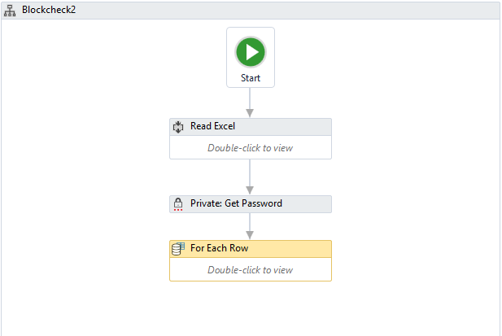
Modules Workflow

Slide 7
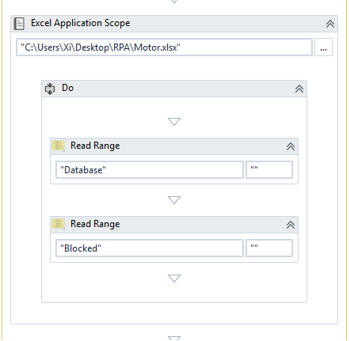
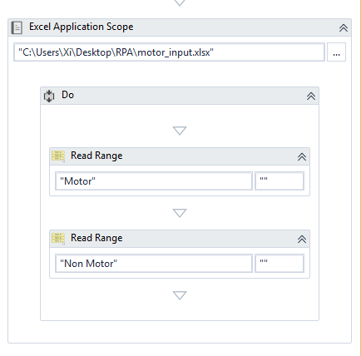
Module 1: Read Excel Files

Slide 8
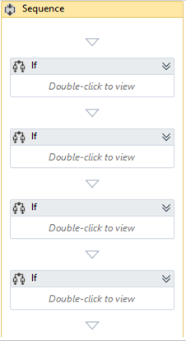
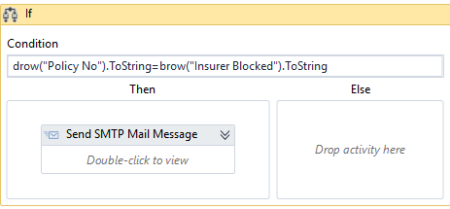
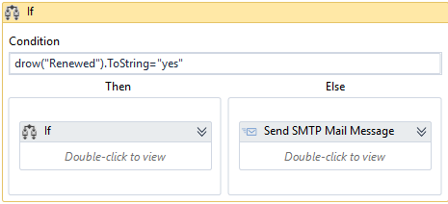
Module 2: Check for Block list & Renewal

Slide 9
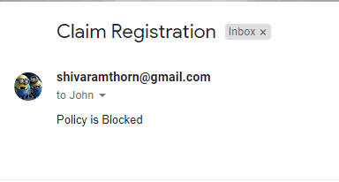
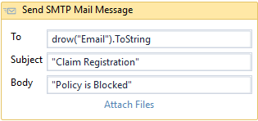
Module 3: Mail Automation

Slide 10
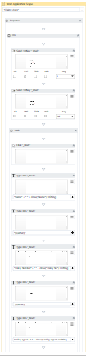
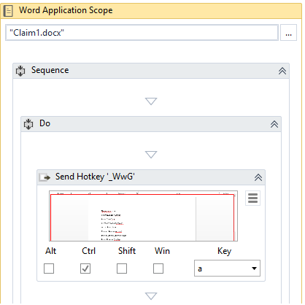
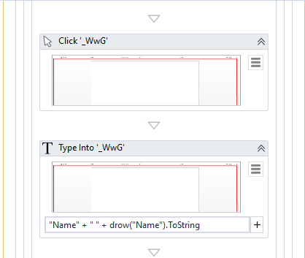
Module 4: Pdf Generation

Slide 11
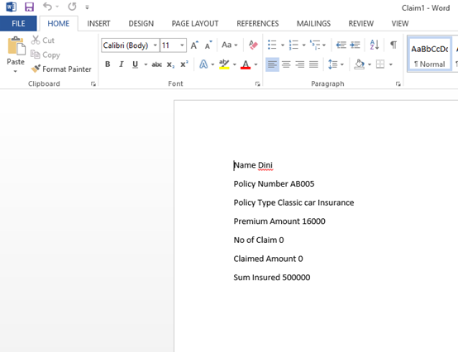
Module 4: Pdf Generation

Slide 12
Architecture Diagram
Database
Reads the Policy holder details
Check for Block list
Account Blocked
Cannot claim
Account Not blocked
Agent
Claim Registered Successfully
Claim Process
Account renewed
Check for account renewal
Send notification to policy holder
Account not renewed

Slide 13
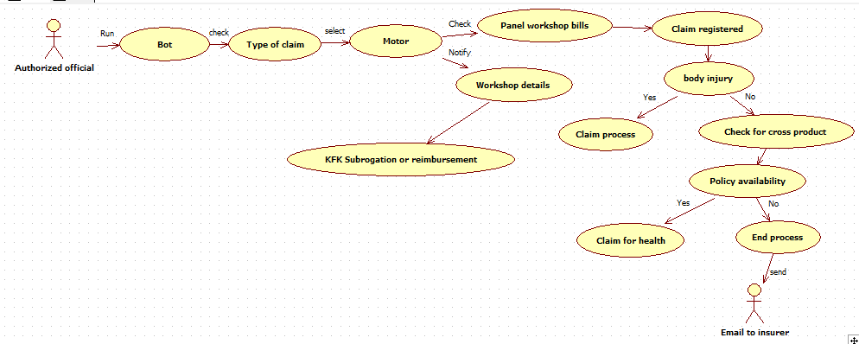
Use Case Diagram

Slide 14
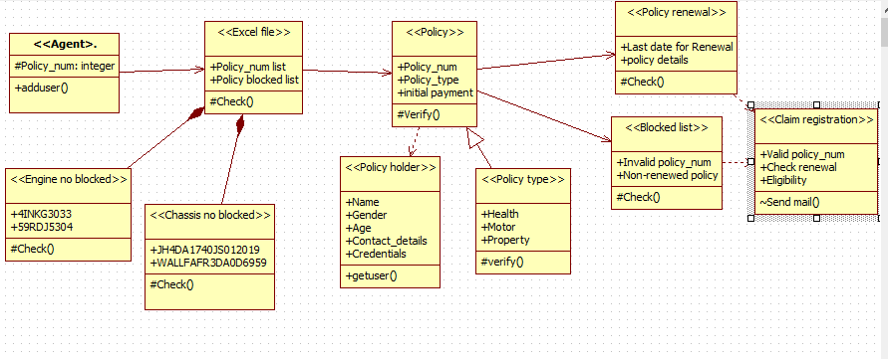
Class Diagram 1

Slide 15
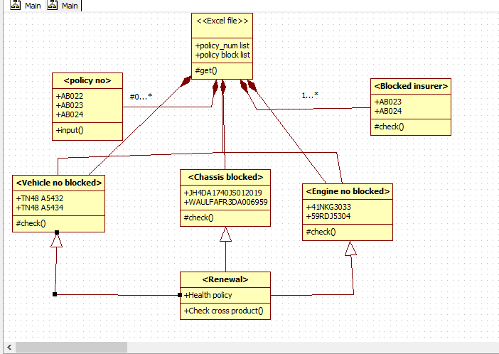
Class Diagram 2

Slide 16
Requirement analysis for each module.
Excel Automation
Read the Excel sheets input data and data where all insured policyholder data are stored.
Check List
Check the input data with block list whether the insure holder is blocked or motor vehicle is blocked etc
Cross Product Checking
If the motor policy is request for check for any personal accident policy is claim requested.
Estimate Claim Eligibility
Calculating the eligibility and estimating the amount that the person can claim.
PDF Generation and Mail Automation
Generates pdf with claim details and mail it to the policy holder.

Slide 17
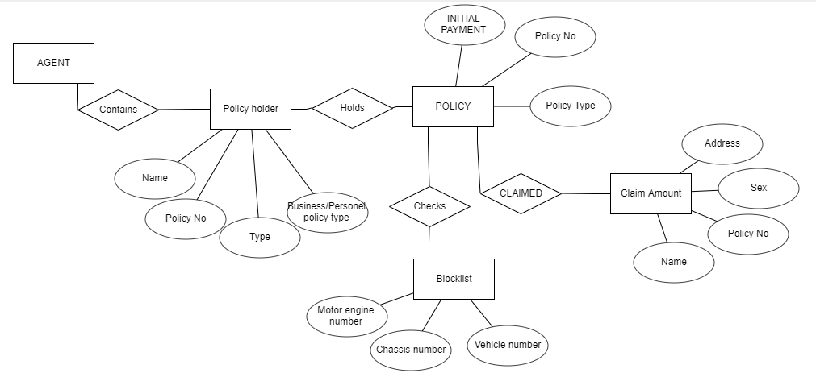
ER Diagram

Slide 18
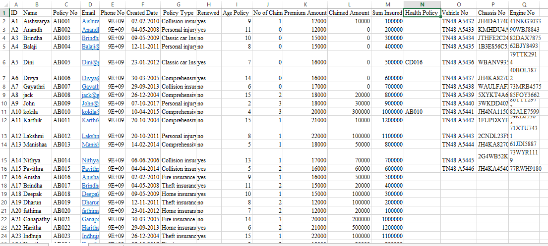
Excel File Database Sheet

Slide 19
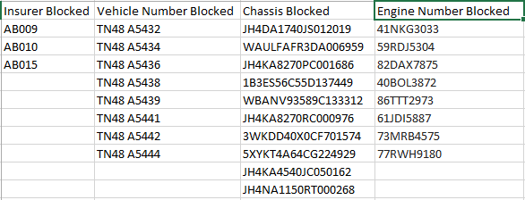
Excel File Blocked Sheet

Slide 20
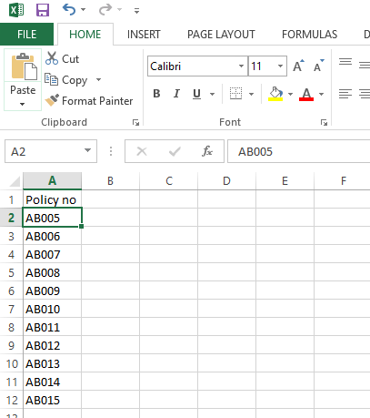
Excel File Motor Input Sheet

Slide 21
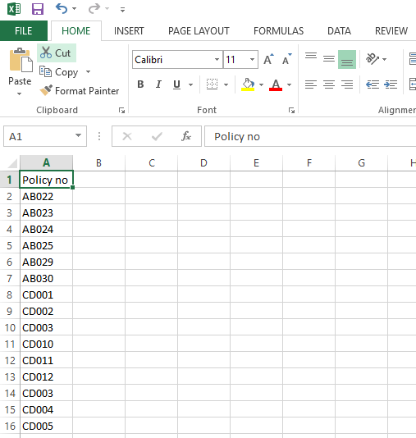
Excel File Non Motor Sheet

Slide 22
Testing Plan
Read Excel File and Perform Checking : On Process
Check For Cross Product : On Process
Estimation For Eligibility : Not Yet Processed
Mail Automation : Complete
Ms Word Creation : Complete
Export To PDF : Complete

Slide 23
Conclusion
The claim registration automation is based on general insurance with different policy type .We enhanced the process to check for the policyholder is in block list or not and also insured person must renewed his/her account properly. If policy holder fails to update then the bot send the notification to renew the account.And also gives information about the Blocked list based on the payment and other issues of the policy holder.

Slide 24
Questions?

Slide 25
Thank You

